Slide 1
7 Cs of communication
Lecture 2
Yasir Saleem

Slide 2
7 Cs of communication
The 7 Cs of Communication is a checklist that helps to improve the professional communication skills and increases the chance that the message will be understood in exactly the same way as it was intended.

Slide 3
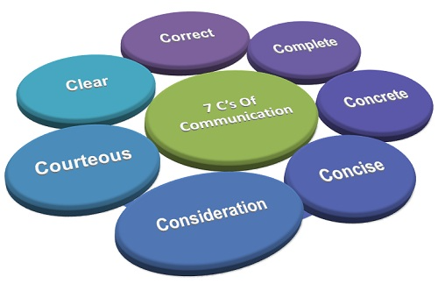

Slide 4
1. Clear/ Clarity
When writing or speaking to someone, be clear about your goal or message. What is your purpose in communicating with this person? If you’re not sure, then your audience won’t be sure either.
To be clear, try to minimize the number of ideas in each sentence. Make sure that it’s easy for your reader to understand your meaning. People shouldn’t have to “read between the lines” and make assumptions on their own to understand what you’re trying to say.
Information and actions required, must be clear so the reader has the information they need to take action.
Notes:
It makes understanding easier.
Complete clarity of thoughts and ideas enhances the meaning of message.
Clear message makes use of exact, appropriate and concrete words.

Slide 5
2. Concise / conciseness
When you’re concise in your communication, you stick to the point and keep it brief. Your audience doesn’t want to read six sentences when you could communicate your message in three.
Are there any adjectives or “filler words” that you can delete? You can often eliminate words like “for instance,” “you see,” “definitely,” “kind of,” “literally,” “basically,” or “I mean.”
Are there any unnecessary sentences?
Have you repeated the point several times, in different ways?
Notes:
It is both time-saving as well as cost-saving.
It underlines and highlights the main message as it avoids using excessive and needless words.
Concise communication provides short and essential message in limited words to the audience.
Concise message is more appealing and comprehensible to the audience.
Concise message is non-repetitive in nature.

Slide 6
3. Concrete/ concreteness
The communication should be concrete, which means the message should be clear and particularly such that no room for misinterpretation is left.
All the facts and figures should be clearly mentioned in a message so as to substantiate to whatever the sender is saying.
When your message is concrete, your audience has a clear picture of what you’re telling them. There are details (but not too many!) and vivid facts, and there’s laser-like focus. Your message is solid.
Notes:
It is supported with specific facts and figures. It makes use of words that are clear and that build the reputation. Concrete messages are not misinterpreted

Slide 7
4. Correct/ correctness
When your communication is correct, it fits your audience. And correct communication is also error-free communication.
Do the technical terms you use fit your audience’s level of education or knowledge?
Have you checked your writing for grammatical errors? Remember, spell checkers won’t catch everything.
Are all names and titles spelled correctly?
Notes:
The message is exact, correct and well-timed.
If the communication is correct, it boosts up the confidence level.
Correct message has greater impact on the audience/readers.
It checks for the precision and accurateness of facts and figures used in the message.
It makes use of appropriate and correct language in the message.

Slide 8
5. Complete/ completeness
In a complete message, the audience has everything they need to be informed and, if applicable, take action.
Does your message include a “call to action,” so that your audience clearly knows what you want them to do?
Have you included all relevant information – contact names, dates, times, locations, and so on?
Notes:
Complete communication develops and enhances reputation of an organization.
Moreover, they are cost saving as no crucial information is missing and no additional cost is incurred in conveying extra message if the communication is complete.
A complete communication always gives additional information wherever required. It leaves no questions in the mind of receiver.
Complete communication helps in better decision-making by the audience/readers/receivers of message as they get all desired and crucial information.
It persuades the audience.

Slide 9
6. Consideration
The sender must take into consideration the receiver’s opinions, knowledge, mindset, background, etc. in order to have an effective communication. In order to communicate, the sender must relate to the target recipient and be involved.
Focus on “You” and “We” rather than “I”
Make sure your message is coherent
When your communication is coherent, it’s logical. All points are connected and relevant to the main topic, and the tone and flow of the text is consistent
Notes:
Emphasize on “you” approach.
Empathize with the audience and exhibit interest in the audience. This will stimulate a positive reaction from the audience.
Show optimism towards your audience. Emphasize on “what is possible” rather than “what is impossible”. Lay stress on positive words such as jovial, committed, thanks, warm, healthy, help, etc.

Slide 10
7. Courteous / courtesy
It implies that the sender must take into consideration both the feelings and viewpoints of the receiver such that the message is positive and focused at the audience. The message should not be biased and must include the terms that show respect for the recipient.
Courteous communication is friendly, open, and honest. There are no hidden insults or passive-aggressive tones. You keep your reader’s viewpoint in mind, and you’re empathetic to their needs.

Slide 11
Variations
Here are a few variations of the 7 Cs of Communication:
Credible – Does your message improve or highlight your credibility? This is especially important when communicating with an audience that doesn’t know much about you.
Creative – Does your message communicate creatively? Creative communication helps keep your audience engaged.

